Slide 1
Our Own Sense of Place

Slide 2
We are a long standing collective of women artists based in Durham Region with substantial exhibition activity, both individually and as a group. Our work represents a wide range of directions and mediums.
The exhibit Memory & Nature in 2000 marked a major advancement in the collectives’ development of artistic concepts combined with refined individual experimentation and techniques. The Baghdad Museum exhibition existed as a “lamentation on the loss, ambiguities, the collision and propaganda resulting from the looting of the Iraqi National Museum in Baghdad”. (M. Rodgers, 2003). Fluid and Fluid II was an exploration of the undercurrents of abstract and literal interpretations of fluidity. (O. Wlusek, 2007). In 2009, IRIS’ The Edge delivered a matrix of individual boundaries. In the exhibit, Filmic, familial, archival, nostalgic, subjective and objective stances were exposed with the notion of preserving image artefacts from the pre-digital age and extensions to other ideas of the word “filmic. (O. Wlalsenko, 2015). IRIS at 20 was an investigation of museum display practices utilizing archived International Women’s Day collected objects.
Our over twenty years of art making mounting various events such as The Secret Garden have enriched and supported us and our community.
In this exhibition we aspire to highlight a diversity of direction in exploring the interconnectedness of the environment, people and architecture in the landscape. This exhibition connects to the universal aspect of our sense of being and place. The IRIS Group’s exhibition evokes a stream of commonality within the history of the collective. These themes incorporate human nature, environment, and culture, which run through and are reflected in their works. (L. Carmount, 2009).

Slide 3
Exhibitions
Women in Art Projects/CWSE Gallery, OISE, 2017
Iris at 20, Robert McLaughlin Gallery, Oshawa, 2016
Filmic, The Station Gallery, Whitby, 2015
WhiteOut –Iris and Friends/ Toronto Arts Council Gallery, Nuit Blanche, 2014
Oshawa Space Invaders, Downtown Oshawa, 2013, 2014
Iris@Bola, Downtown Oshawa, 2012
Iris in the Adirondacks, BluSeed Studios, Saranac Lake, 2010
The Fiction Project, 2010, art House Brooklyn Art Library, N.Y.
Fluid II, Agnes Jamieson Gallery, Minden, 2009
Edge, The Redhead Gallery, Toronto, 2009
Deviant Detours, The Kunsthaus gallery, San Miguel, Mexico, 2009
Insomnia, The Redhead Gallery, Nuit Blanche, 2008
Fluid, Latcham Gallery, Stouffville, 2007
Baghdad Museum, Propeller Gallery, Toronto, 2005
Baghdad Museum, Latcham Gallery, Stouffville, 2004
Baghdad Museum, Visual Arts Centre of Clarington, Bowmanville, 2004
Memory/Nature, Robert McLaughlin Gallery, 2000

Slide 4
Artists in the Community
The Secret Garden, YWCA, Oshawa, 2014
Beyond Fences, YWCA, Oshawa 2014
International Woman’s day
Central Branch Whitby library, 2011
Artsweek in Peterborough, Millenium Park, 2010
Isabella’s Café, Downtown Oshawa, 2010
BluSeed Studios, Saranac Lake New York 2008,2010
Agnes Jamieson Gallery, Minden 2009
Durham College - UOIT campus Oshawa 2008
Royal Society Conference, U of A, Edmonton 2007
The Robert McLaughlin Gallery, Oshawa 2006
Byng Studio Gallery and Downtown Bowmanville, 2005

Slide 5
Awards
Ontario Arts Council Individual Artist Grants, Material Assistance, 2000-2016
artsVest, Ontario Trillium Funding, 2014
Partnership Grants, City of Oshawa, 2014 and 2012
Catalogues/Publications
Filmic, 2015
White Out, 2014
Nuit Blanche, 2014
Fluid II, 2009
Edge, 2009
Fluid 1, 2007
Museum Baghdad, 2004
Memory /Nature, 2000
Women in . . . Volumes 1 - 3 2005 - 2010

Slide 6
Mary Ellen McQuay
Sheltering in Place
If one can have a favourite phrase from the tangled and complex time of Covid-19, mine is ‘Sheltering in Place’.
Usually, in the early spring, when winter colours change to soft greens, yellows and reds, I wander conservation areas and lakefront beaches with my camera.
Somewhat pensive and solitary, I watch for images both intimate and curiously familiar. If those images suggest a human narrative, all the better. But that quiet quest didn’t happen this spring. The conservation areas and beaches were closed. Covid-19 kept most of us locked down at home.
The phrase “Sheltering in Place” continued to echo in my mind. It calmed me. Yet as the weeks rolled on and the pandemic spread, the layers bubbling beneath the calm surface of sheltering revealed themselves. Many felt exhausted, anxious and at risk - essential workers, multigenerational families living in cramped quarters and those isolated at home alone.
Not able to photograph in my favourite places I re-visited photographs I’ve made in years past. I searched for images that gave me a sense of the layers – the strength, the peace, the longing and the complexity - that may be embedded in the idea of sheltering that has touched us all.
http://www.theirisgroup.ca/mary-ellen-mcquay-images.html

Slide 7
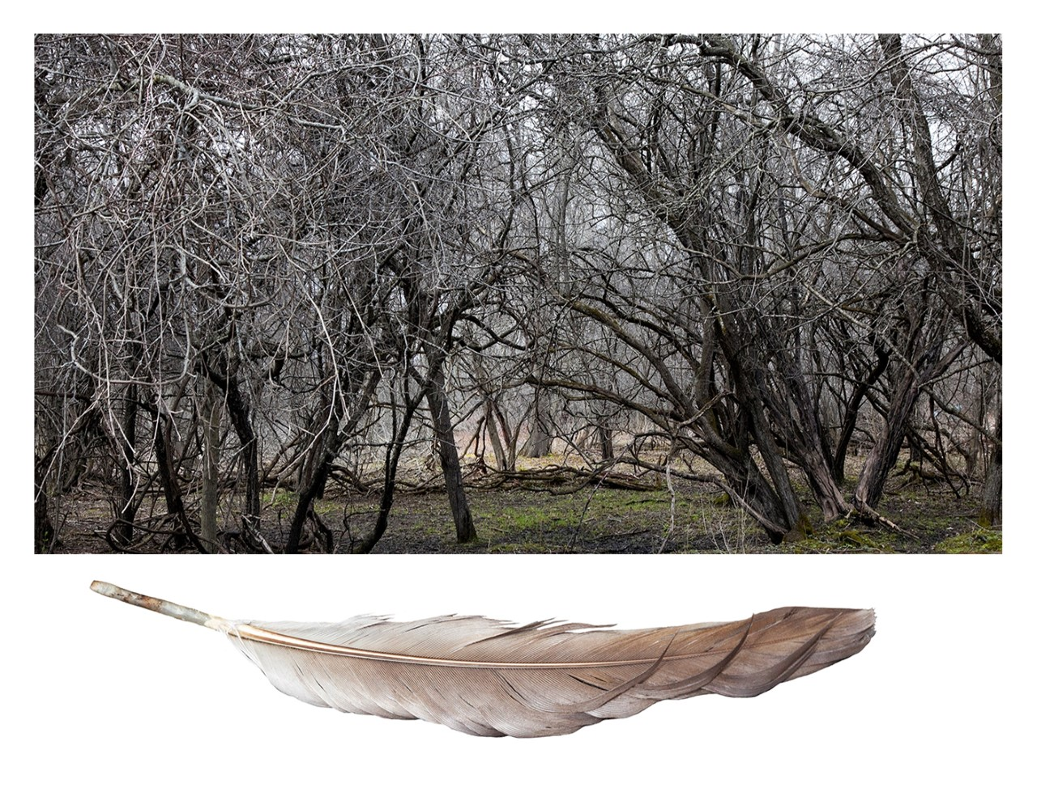
1

Slide 8
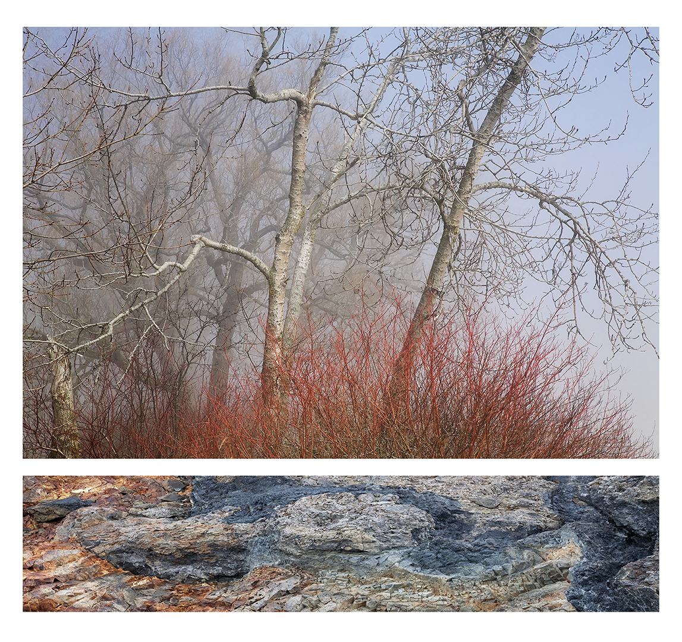
2

Slide 9
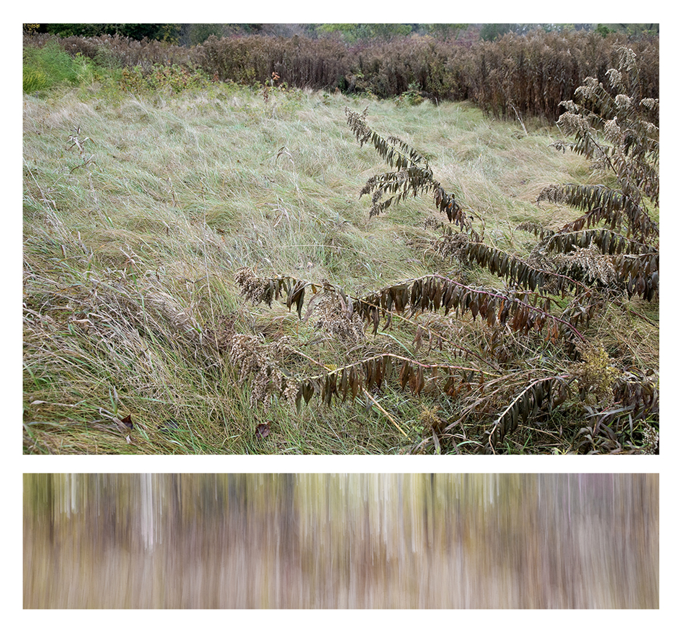
3

Slide 10
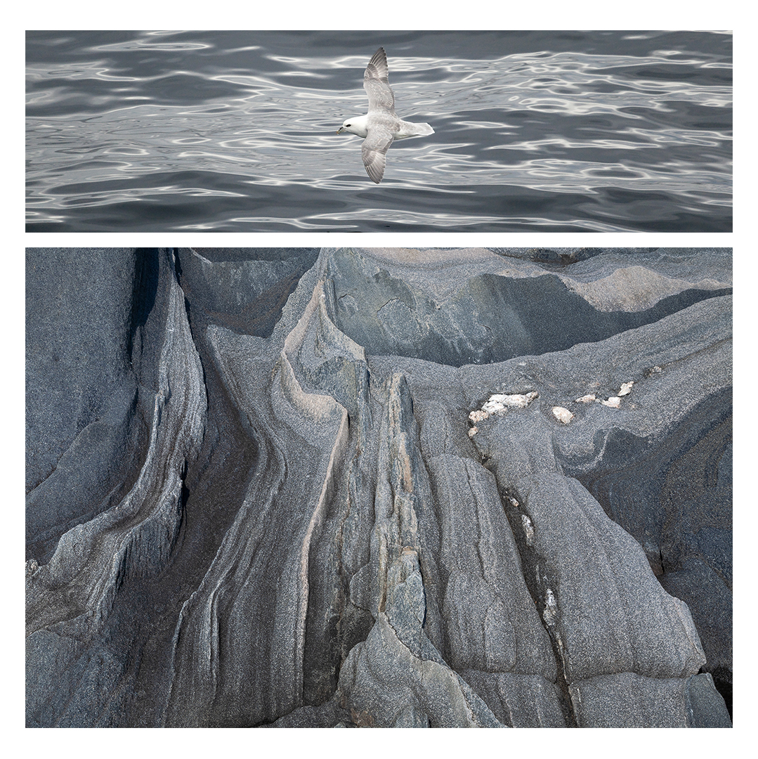
4

Slide 11
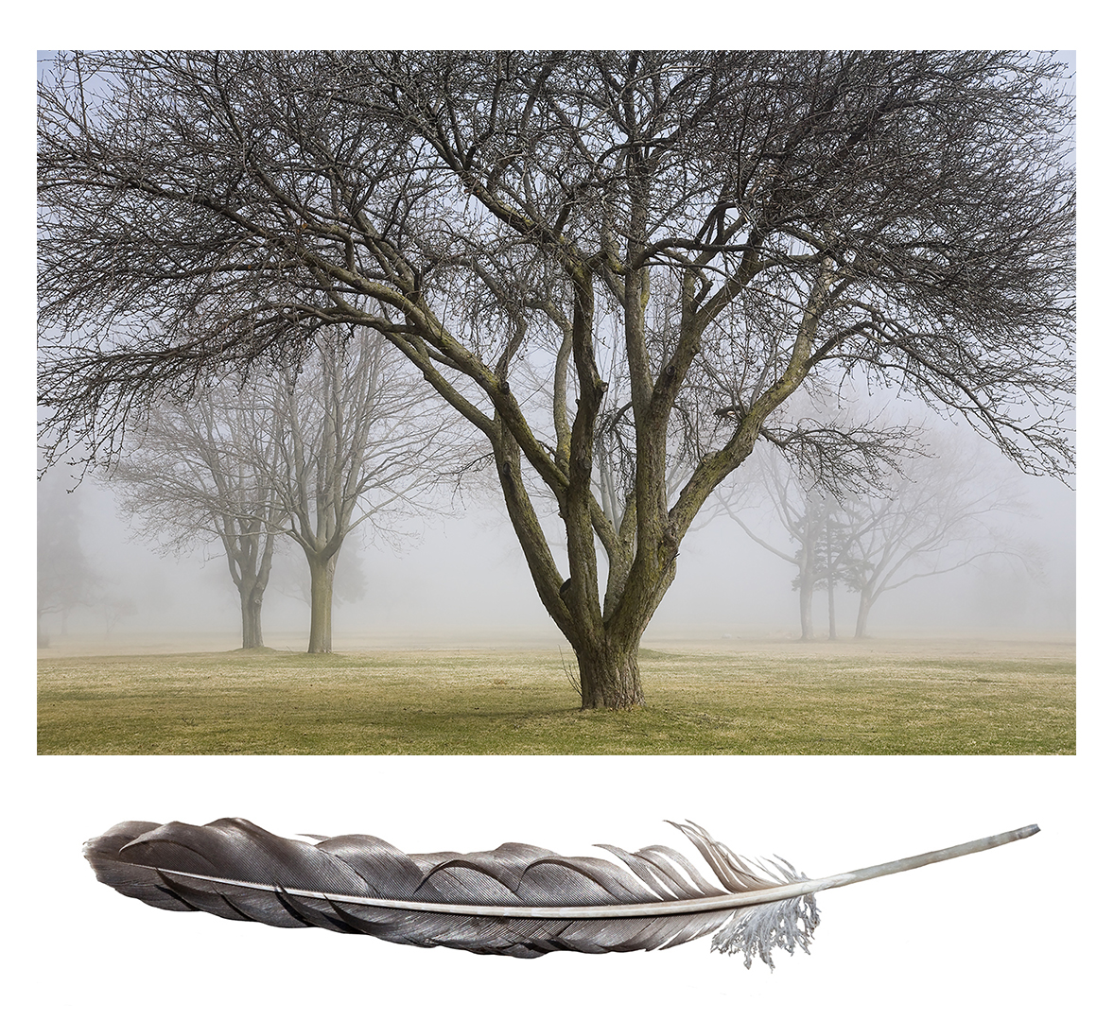
5

Slide 12
Laura M. Hair
In nature, all attributes are appreciated and continually utilized in organic development. We recognize these harmonious designs and structural certitudes as they are integral to our physiology. These interrelations form my aesthetic judgment.
In my art practise, I use a variety of materials while exploring combinations of similar, anatomical components, focusing on content metamorphosis. Integrated forms arise from the work surface; visual amalgams of images shift and bisect each other in a stratification of information.
There is a slight hesitation of recognition as boundaries fade, dimensions alter and subject identities merge. These now aggregated states of being provide evidence of the genetic genesis within the collective natural world.
https://sites.google.com/site/artlmh/home
http://www.theirisgroup.ca/laura-hair-images.html

Slide 13
1. Of Becoming l
36 x 30 inches
Graphite on Mylar and Linen
2010
2. Widow’s Weeds_Detail
Installation – 180 x 72 inches
Ink, acrylic, graphite and watercolour on paper
2016
3. Margaret’s Amber l_detail.a
Installation – 84 x 120 inches
Ink, 35mm film negatives, aluminum, copper on Mylar
2015
4. Margaret’s Amber l_detail.b
Installation – 84 x 120 inches
Ink, 35mm film negatives, aluminum, copper on Mylar
2015
5. To Walk the River Flow_1
84 x 32 inches
Acrylic on wood
2016
Laura M. Hair

Slide 14
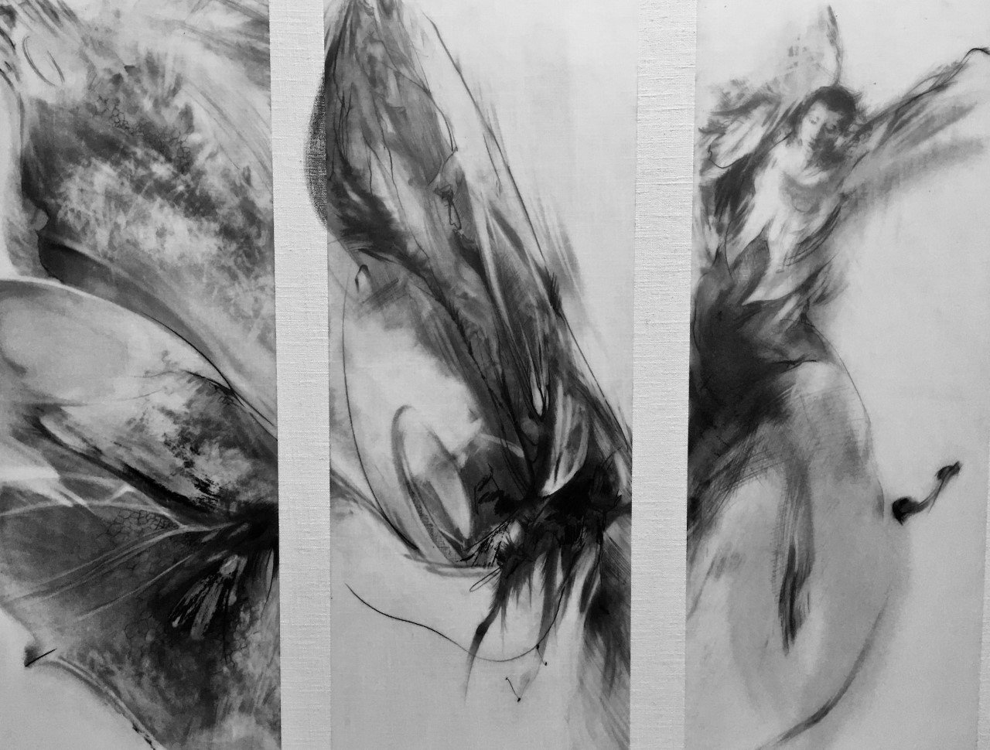
1

Slide 15
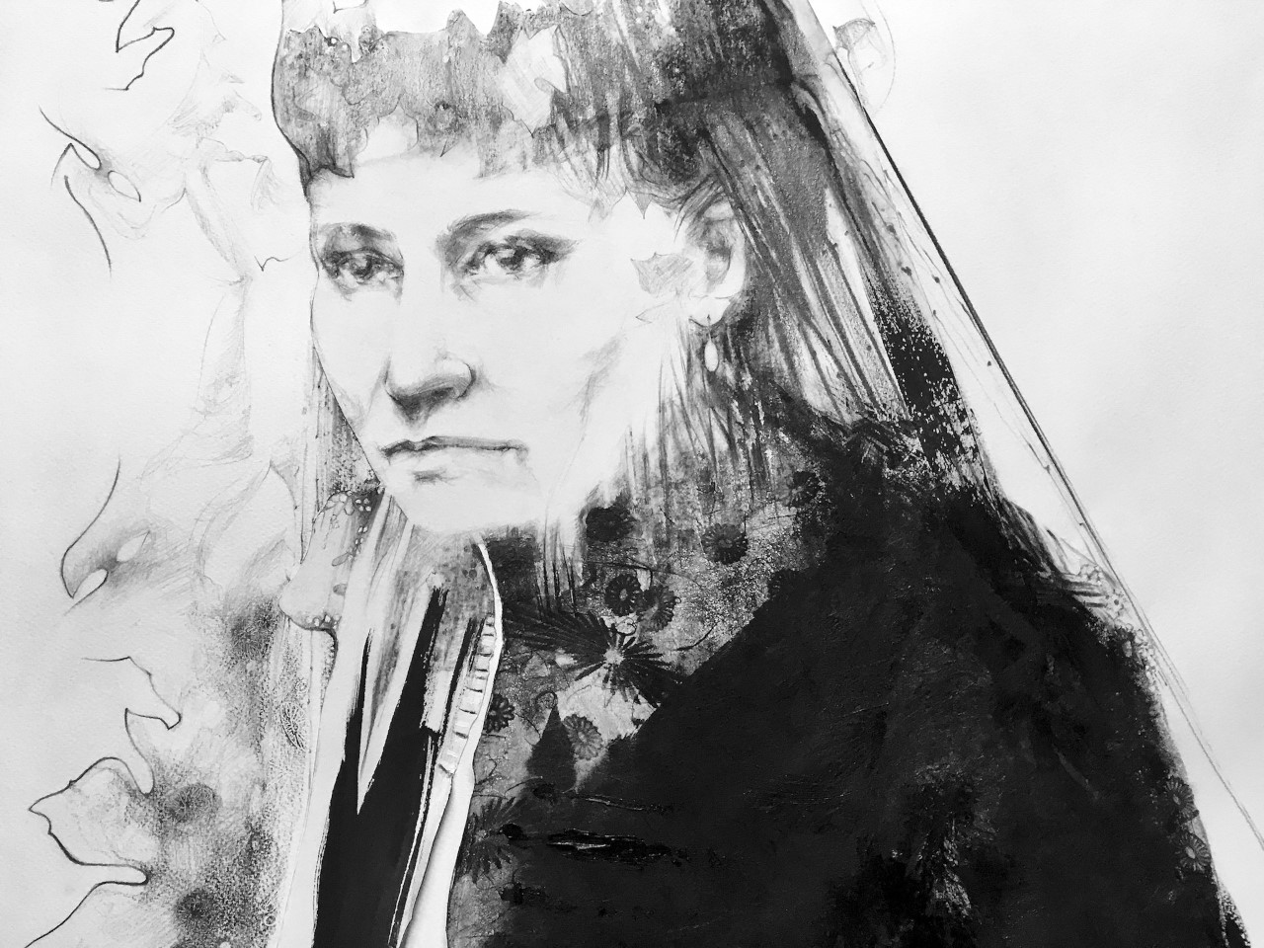
2

Slide 16
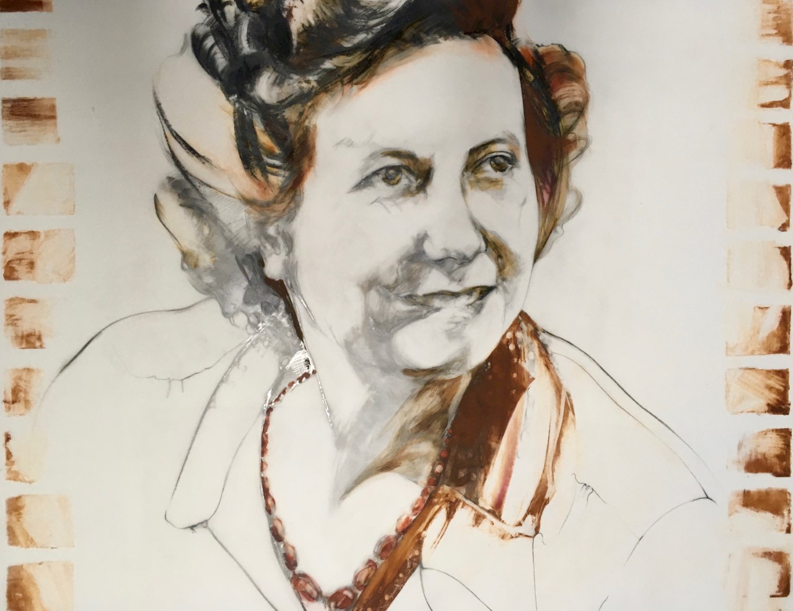
3

Slide 17
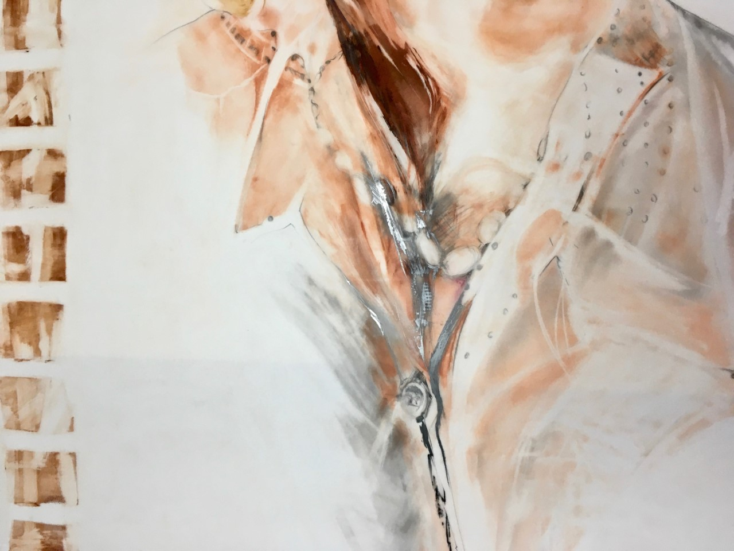
4

Slide 18
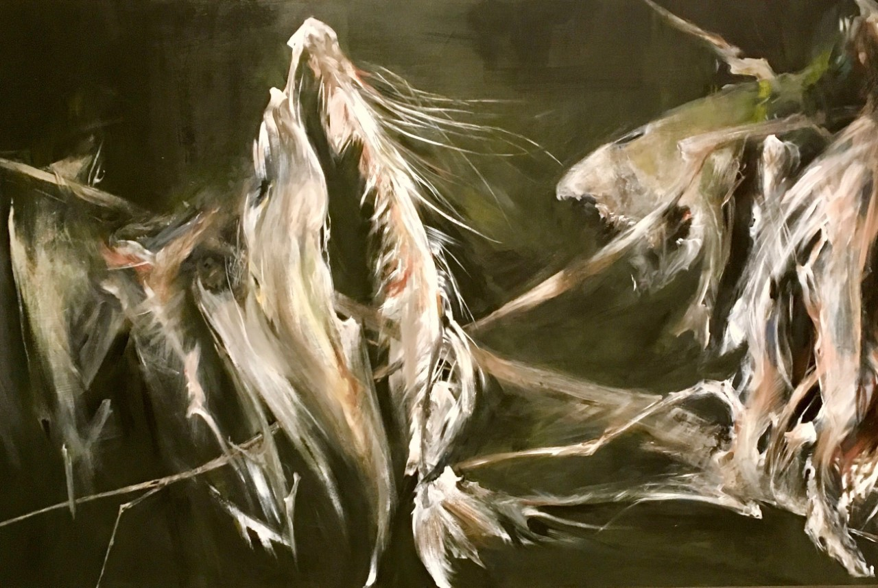
5

Slide 19
Janice Prebble
Janice Taylor-Prebble works in mixed media, with a focus on printmaking and painting and recently set & costume design. Exhibits include China-Canada International Calligraphy, Painting and Art Exhibition at The Beijing National Art Museum; BlueSeed Studios Saranac Lake, New York; Agnes Jamieson Gallery, Minden; Robert McLaughlin Gallery, Oshawa; The Visual Arts Centre, Bowmanville; Open Studio, Toronto. Janice is a graduate of Georgian College and OCAD with a year study in Florence Italy.
The piece "Beyonce Tower" is cut out of a sheet of steel and is part of the continuing Tower Series. For almost ten years Janice has been photographing Durham's hydro towers, fascinated by the structures that appear as beautiful etched lines against the huge colour field of the sky. Most people say that don't notice the towers.
Bringing our attention to them with a gentle reminder of the region's responsibility to create power with care, Janice Taylor-Prebble morphs the shapes from geometric into organic, usually with a reference to the female form. The feminist joke: now that's a powerful woman! Always in mind.
http://www.theirisgroup.ca/janice-taylor-prebble-images.ht

Slide 20
Janice Prebble
1. A history of small gatherings (Installation)
2. A history of small gatherings (Installation)
3. Tower Power Grid
30 x 60 inches
Acrylic and Gold Foil
2016
4. Beyonce Tower
3/8” cold pressed steel, water-jet cut
48 x 96 inches
2018
5. GoldenTower1
8 x 10 inches
Image Transfer with ink and Gold Leaf
2016

Slide 21
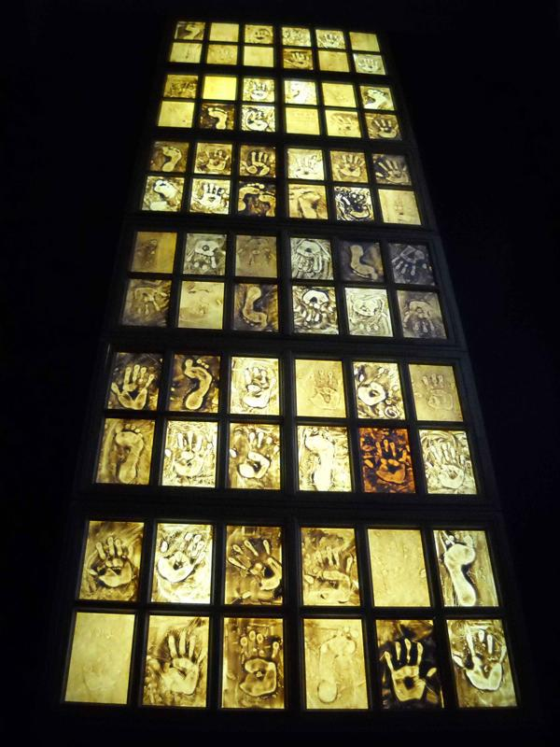
1

Slide 22
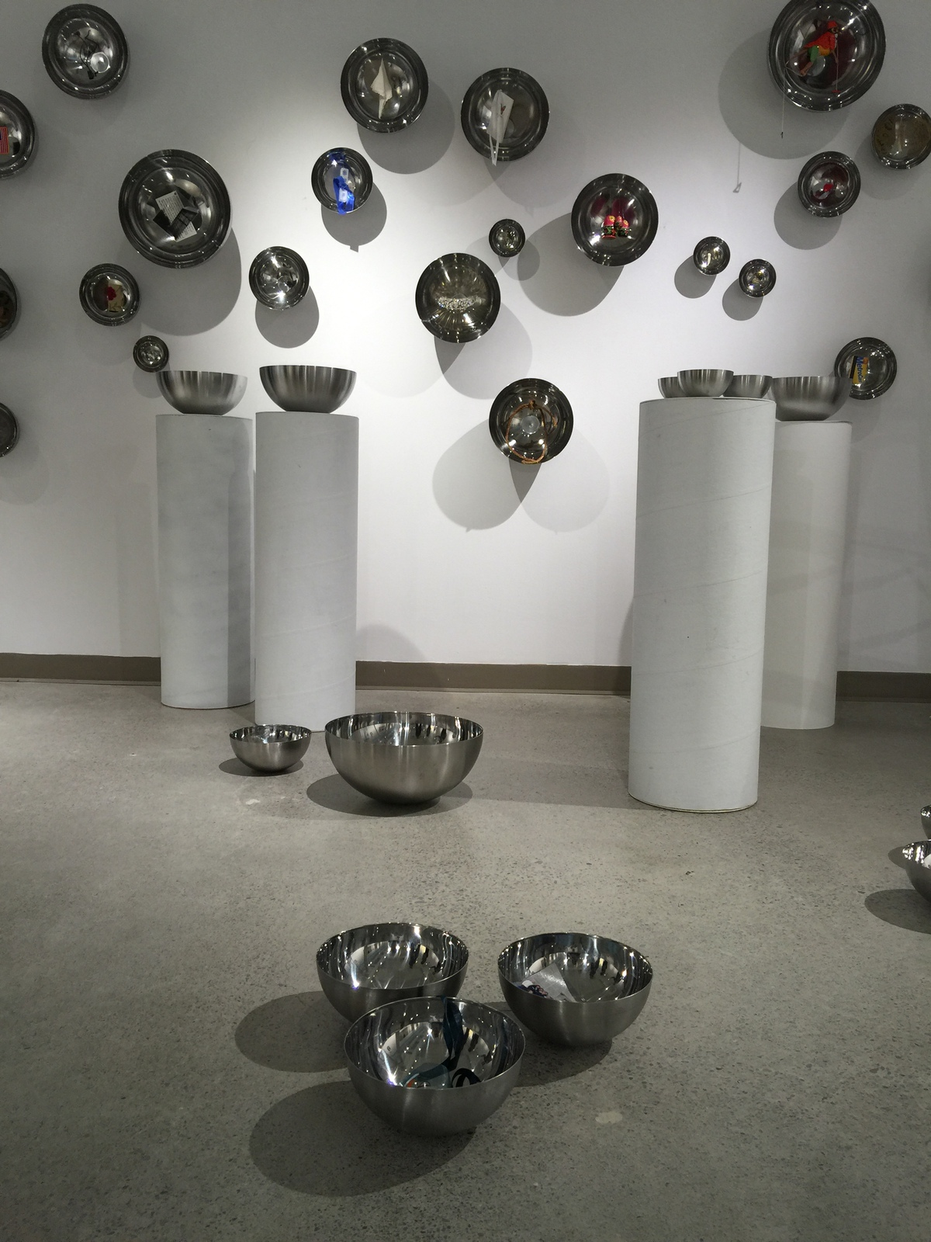
2

Slide 23
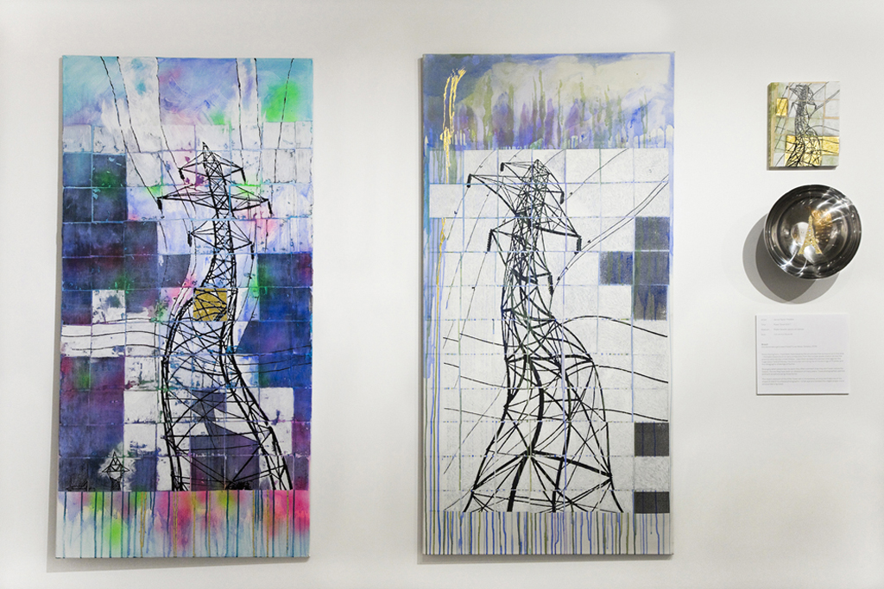
3

Slide 24
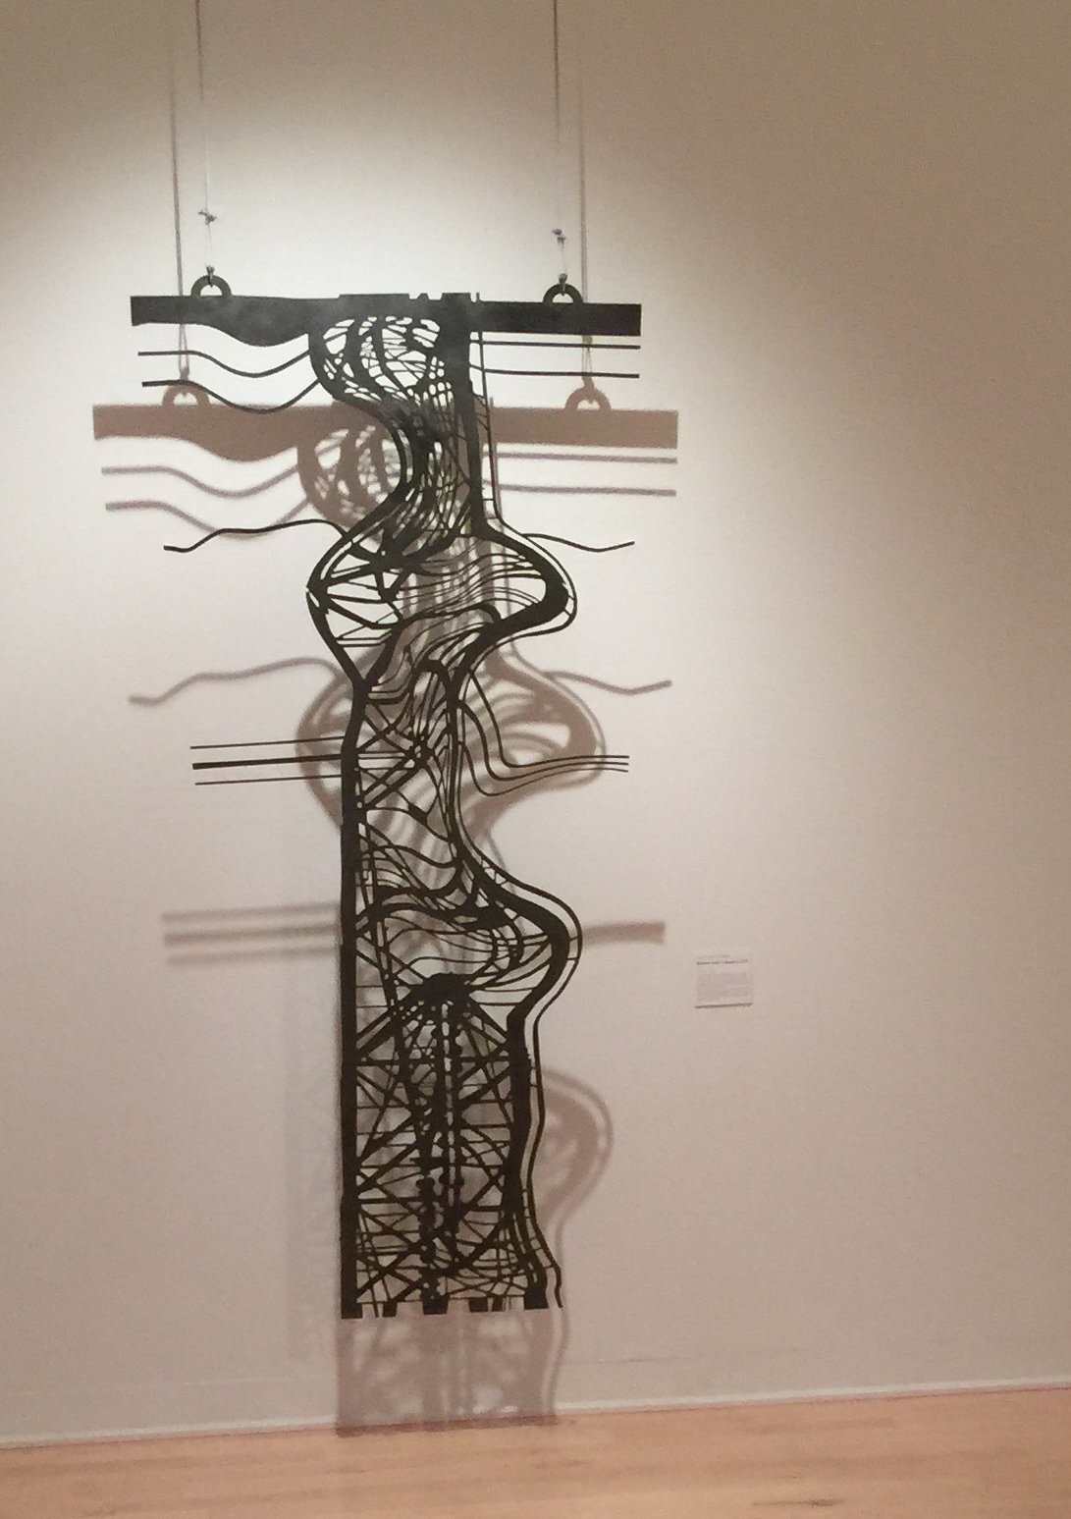
4

Slide 25
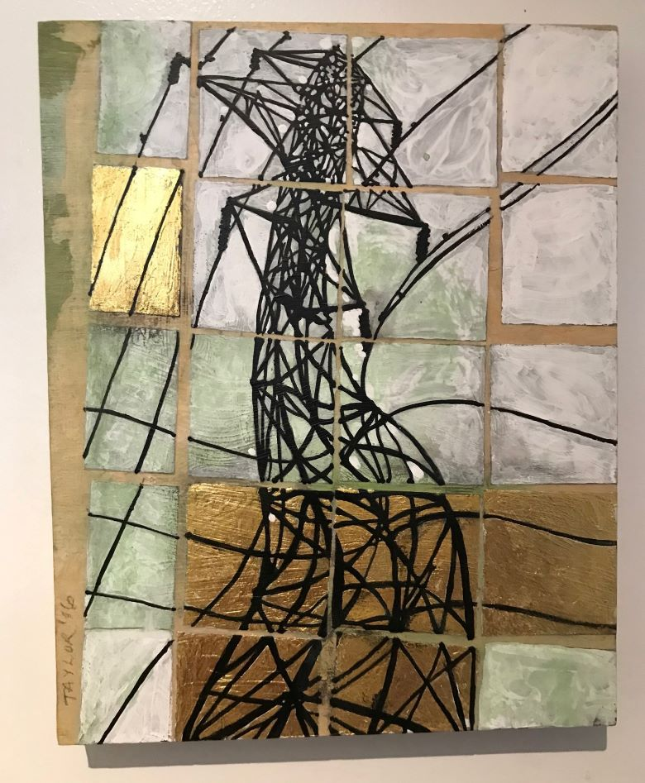
5

Slide 26
Judith Mason
The Last Quadrant [a series of works from Cairo, 2019] If I think of how I approach painting, I would say it’s as action, without any preconceived ideas of content, form or even colour. My most recent painterly work, The Last Quadrant, is a series of paintings that employ elements of collage/montage causing a subtle rupture in the surface. Each painting explores, finds, reveals, transfers, organizes, combines, constructs, assembles and seemingly builds on itself. I use intuition as my guiding principle - a mixture of thinking and feeling - to solve a series of painterly problems. These problems emerge by chance or choice, but they are problems nonetheless that require continuous engagement. I do not always know when each piece finds the fullness of its own iteration, or liberation. Each painting has to satisfy over a period of time.

Slide 27
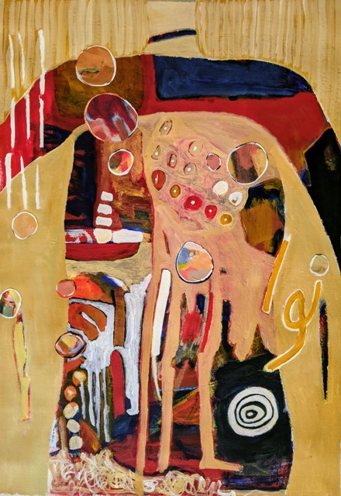
1

Slide 28
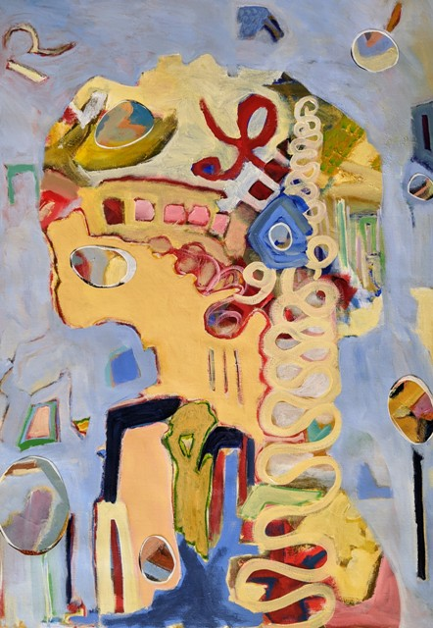
2

Slide 29
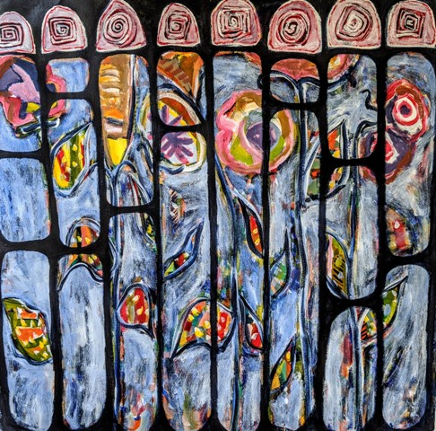
3

Slide 30
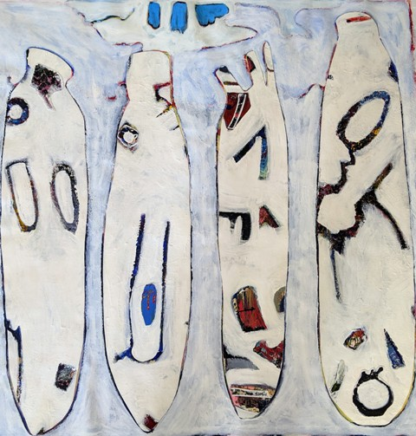
4

Slide 31
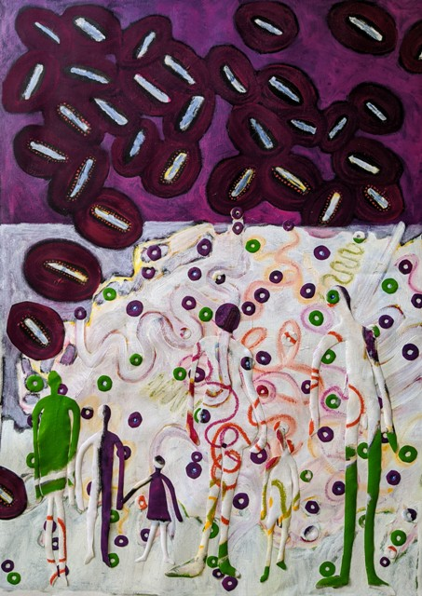
5

Slide 32
Margaret Rodgers
Margaret Rodgers is an Oshawa artist, writer, and curator working in various media including painting drawing, and photo-based work with particular interest in solar printing. At present she is employing a range of processes to create a series of text and image based pieces using the crossword puzzle as form and various theoretical language silos as content. That said, painting remains the pivotal element in her process. This exhibition employs a combination of painting and collage using a solar printing technique, digitally manipulated and applied on antique linens. From a playful parody of lockdown pastimes, the project moved in revisiting the writings of early French feminists and their essentialist rhetoric. While fallen into the bin of history I find that they still hold relevance.
Recent exhibition venues with the IRIS collective has included OISE, RMG Oshawa, Station Gallery Whitby, downtown Oshawa Space Invaders, and WhiteOut for Nuit Blanche. Solo shows include Closeups at RMG, Solar Prints at the Women's Art Association of Canada, and Fort St. John North Peace Museum, B.C. Her work has been included in No Man's Land (Erring on the Mount festival, Peterborough), Easy Come, Easy Go (AGP), and various WAAC art exhibitions. Internationally: Deviant Detours, Kunsthaus Gallery, San Miguel de Allende, Mexico, Beijing World Art Museum, and the Lake Placid/Saranac Lake area, NY.
http://www.margaretrodgers.ca/

Slide 33
Margaret Rodgers
1. Marketplace of Ideas acrylic on rag paper 30x22 inches
2. Cixous acrylic, linen, chalk, dye 30x22 inches
3 Julia acrylic on rag paper, linen, dye 30x22 inches
4. Luce acrylic on rag paper, linen, dye 30x22 inches
5. Simone Dye on linen, acrylic, chalk 30 x 22 inches

Slide 34
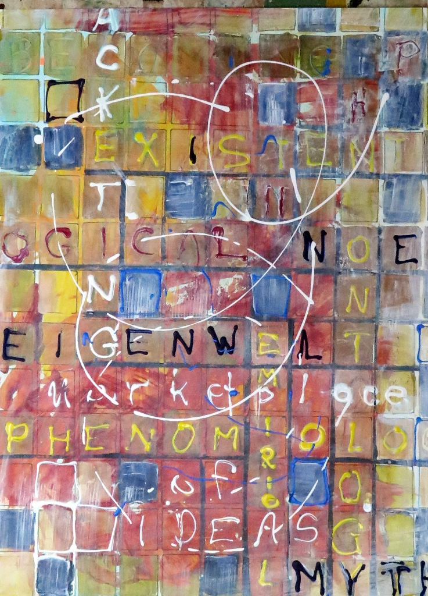
1

Slide 35
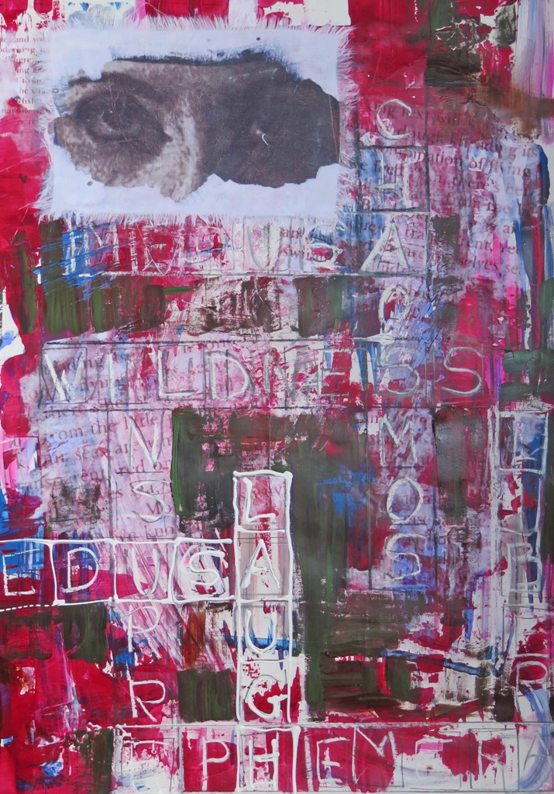
2

Slide 36
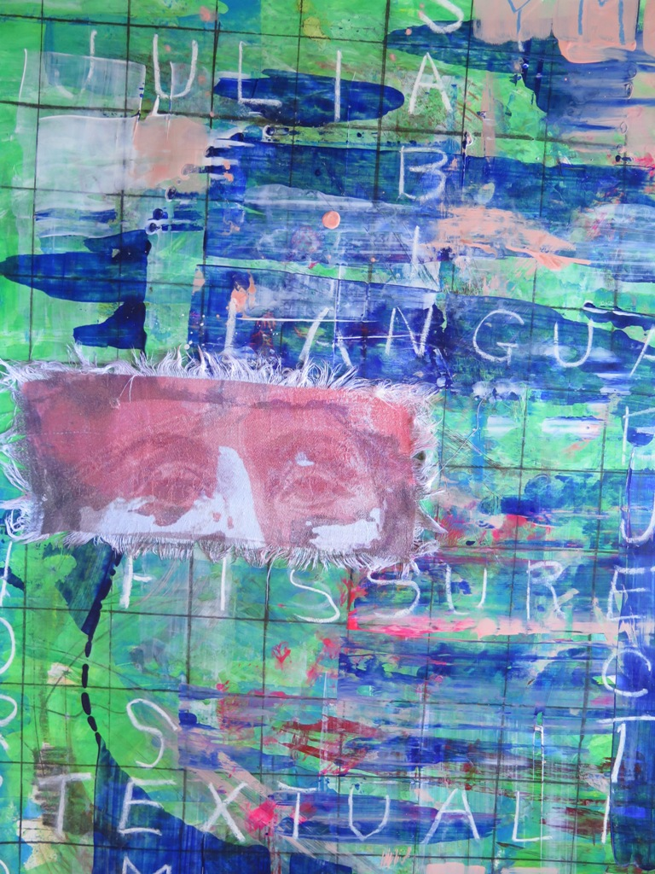
3

Slide 37
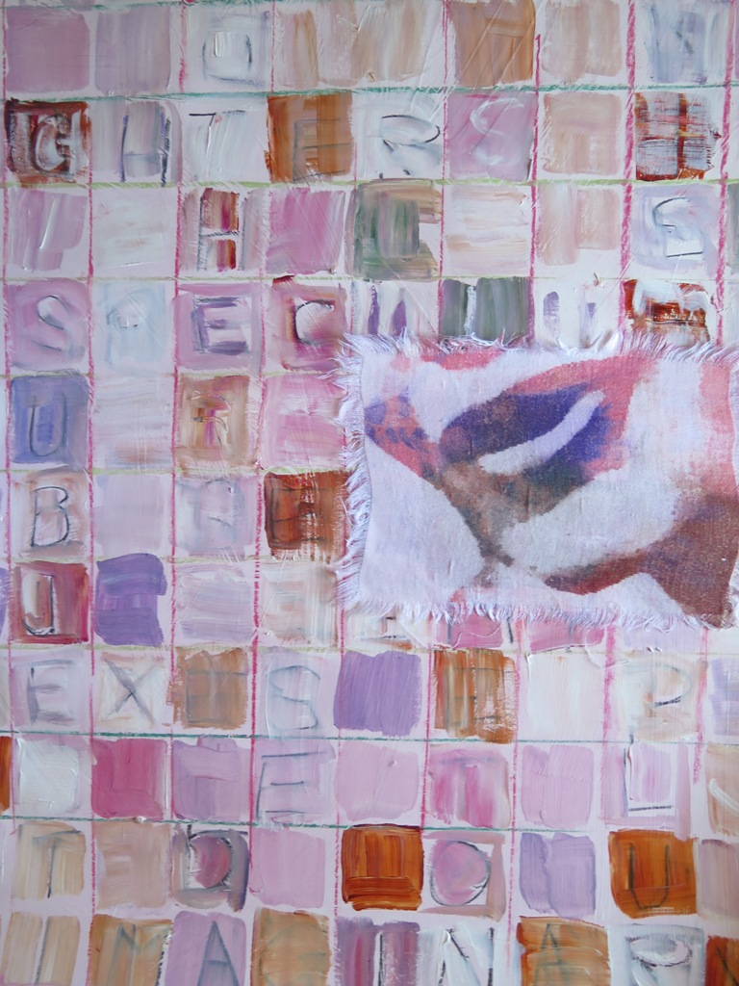
4

Slide 38
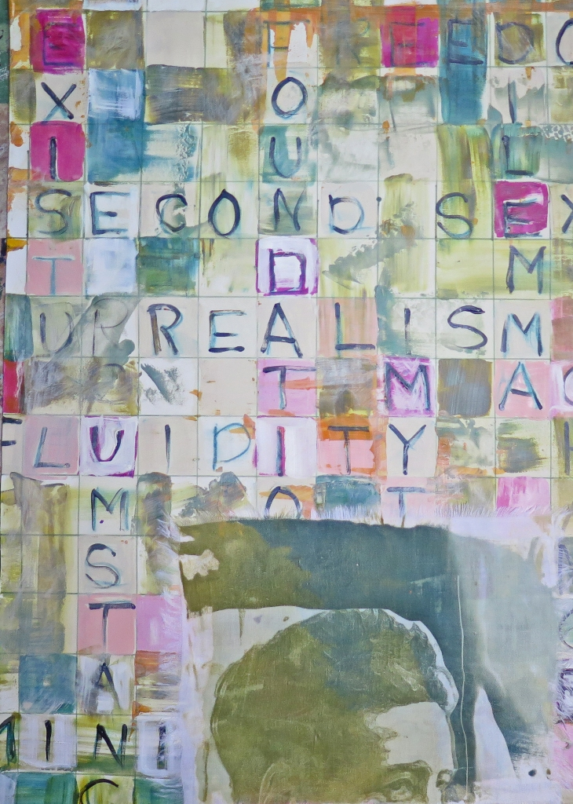
5

Slide 39
Sally Thurlow
RENEWAL speaks of regeneration, Earth re-awakening for spring’s germination and, a silver lining of COVID-19. The industrial world, put on hold, gains healing time from our business as usual, frantic-paced fate, our mobile devices keeping us in virtual touch. Friendships rekindle, essential industries re-tool and societies are changed forever.
RENEWAL also speaks to the continuation of Thurlow’s determination to recycle and revitalize materials, sparking new questions provoking cultural awakenings; making new forms while also combining sculptures renewed by their association.
From 1960s film strips, beach flotsam, mesh food bags, to enchanting antique drapery and upholstery fabrics, this sculptural installation draws on materials collected over time. The film strips were rescued from her daughter’s high school waste bin, the colourful beach flotsam found on many waterfronts; the mesh food bags she collected just in one year of her use, (her life-expressive items placed inside appear to amass on their own). She had stowed away remnants of vintage fabrics for over forty years when she was last designing and selling her one-of-a-kind clothing. These beautiful cottons and linens, some culturally intriguing, some now close to a century old, still stable, are far removed from the low priced synthetic mixed fabrics of today’s fast fashions.
Re-visiting her love of fabrics, she turned them into floor cushions — bolsters, the kind used for meditation or conversations. To this end she has applied to each, the name of a different archetype (based in Jungian psychology), inviting visitors to peruse the collection of forty bolsters laid out on the gallery floor (in a design which also speaks of renewal). Here, visitors may contemplate which could apply either to their present, their past, or to other people they think they know… Whatever visitors decide, by utilizing archetypes to practice solidarity, Thurlow is making space to foster reflection, deliberation and discussion.
http://www.sallythurlow.com/
http://www.theirisgroup.ca/sally_thurlow.html

Slide 40
Sally Thurlow
1. Recurrent Patterns , 2020
40 of 40 antique fabric bolsters, cotton-filled
with mixed Media in plastic mesh bags
15 x 60 x 30 cm each
2. Recurrent Patterns (Detail), 2020
27 of 40 antique fabric bolsters, cotton-filled
15 x 60 x 30 cm each
3. Mesh of Life (Detail) 2020
Mixed Media in plastic mesh bags
2.4 m x 1.35 m x 12 cm
4. Recurrent Patterns (Detail), 2020
6 antique fabric bolsters, cotton-filled
15 x 60 x 30 cm each
5. Recurrent Patterns (Detail), 2020
6 antique fabric bolsters, cotton-filled
15 x 60 x 30 cm each

Slide 41
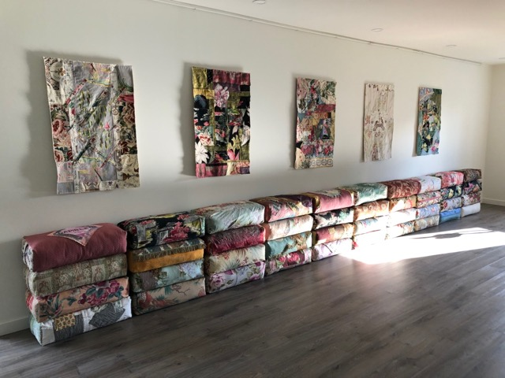
1

Slide 42
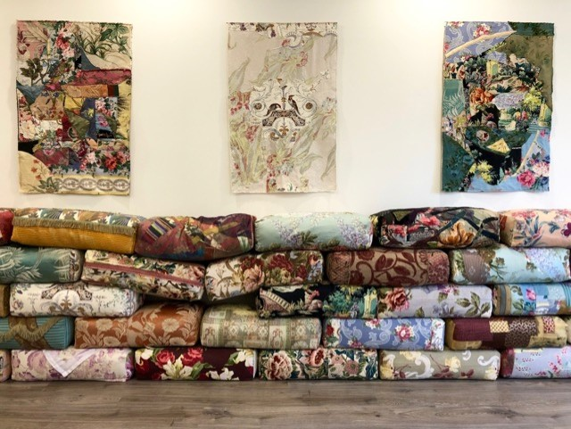
2

Slide 43
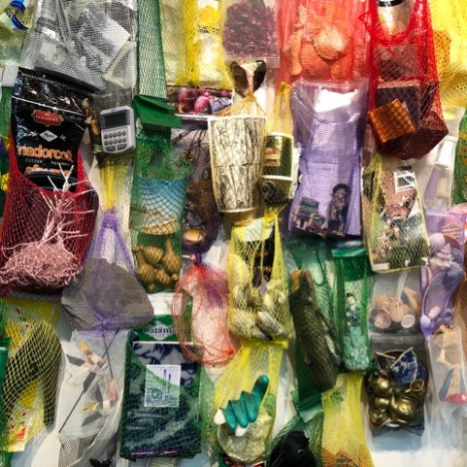
3

Slide 44
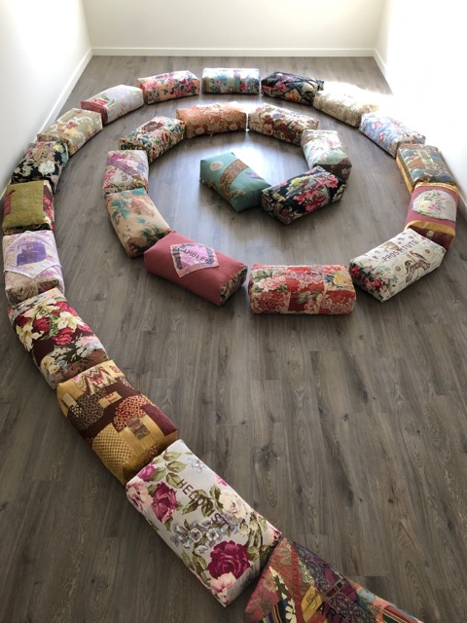
4

Slide 45
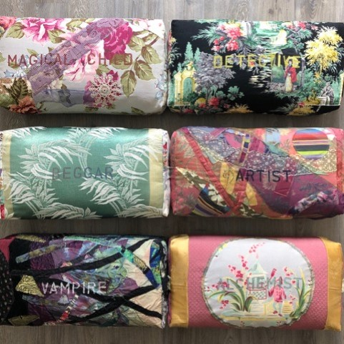
5

Slide 46
Wendy Wallace
I create constructions on-site connecting traditional, natural, textural, and everyday materials that are symbolic of the narrative. Currently, I am working with light, shadows, and reflections integrating materials and documenting with photography.
My work responds to my interaction in local landscape, travels and short residencies throughout Canadian urban/rural/suburban environments. I am exploring the carbon footprint local to unfamiliar, they are landscapes centred on the impact of the narrative, “identifying landscapes as cultural symbols”.
The series of photographs "Submerged" is based on my family’s land and forest, installation of laminated tree photographs suspended and submerged in moving water with, light, shadows, and reflections. I am interested in the possibilities of reflecting what is now versus what was, reflecting the interconnectedness of the forest, rocks and water along the Muskoka River, flooded by hydro dams in the 1950s.
http://www.wendywallace.ca/
http://www.theirisgroup.ca/wendy-wallace-images.html

Slide 47
Wendy Wallace
Forest Reflections and the Learning Tree
Digital File
Canon EOS DSLR Camera
2019
Rocks
Digital File
Nikon D3400 DSLR Camera
2019
Submerged #1 and #2
Digital File
Nikon D3400 DSLR Camera
2019
Plasticity #1
Digital File
Iphone-11Pro
Pro Camera App
2020
Plastcity #2
Digital File
Iphone-11Pro
Pro Camera App
2020

Slide 48
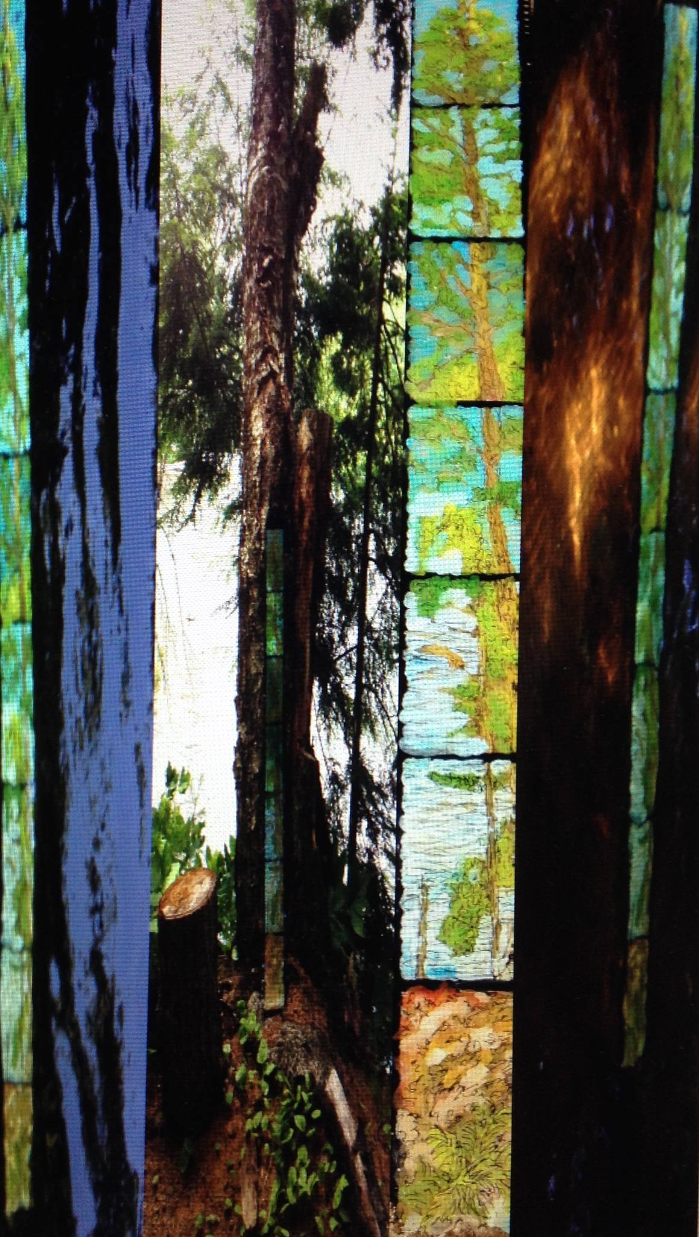
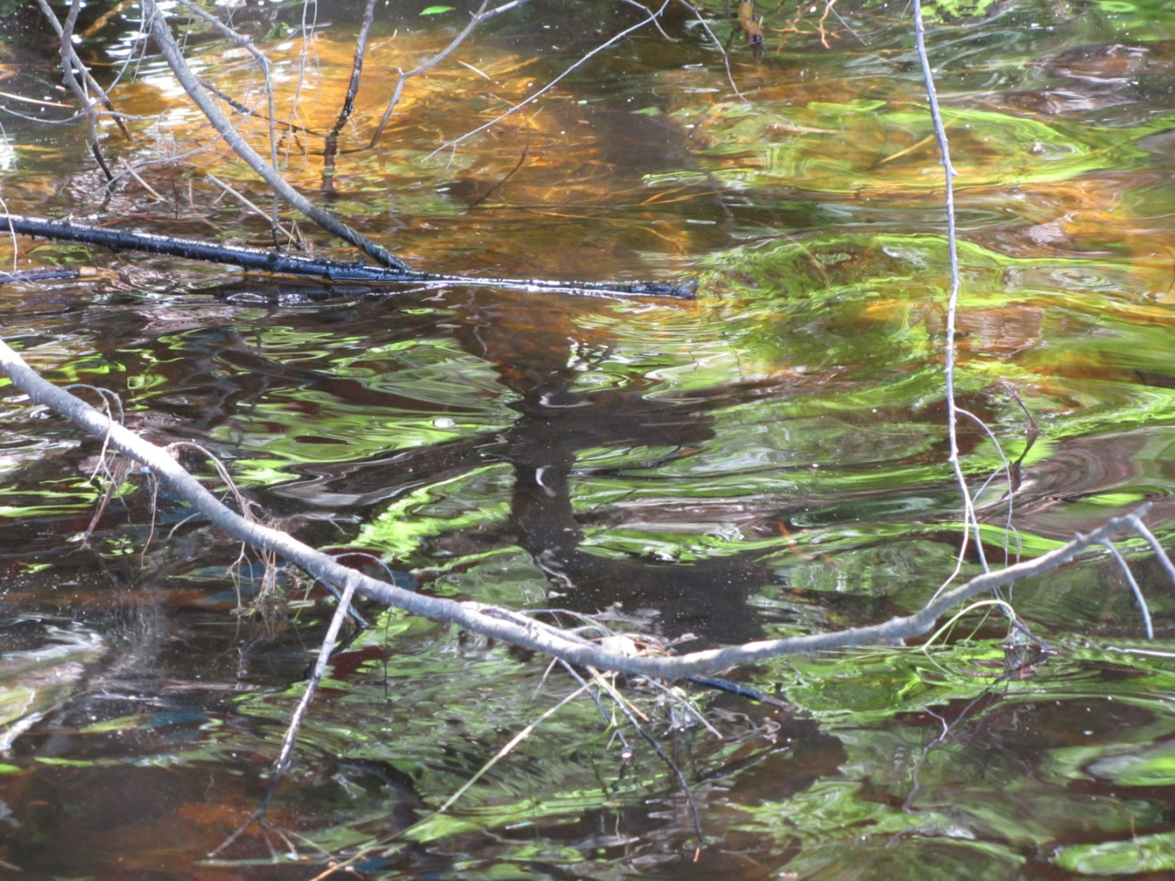
1

Slide 49
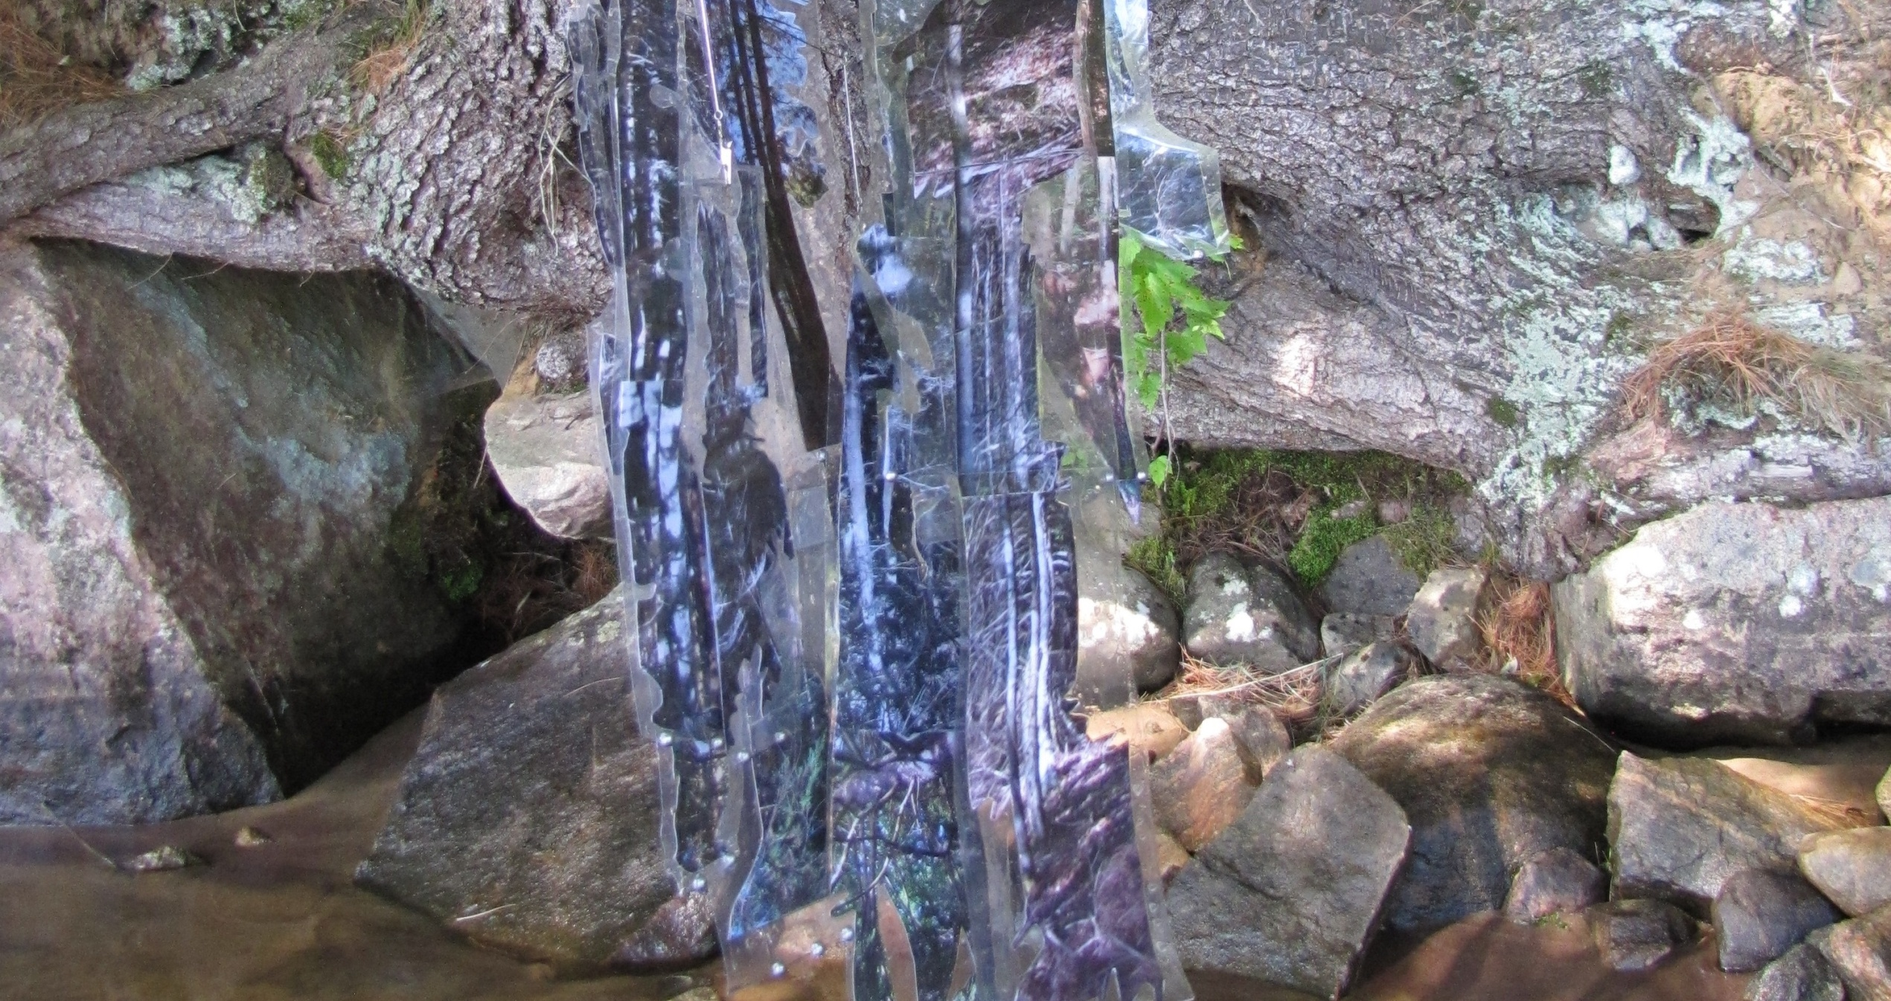
2

Slide 50
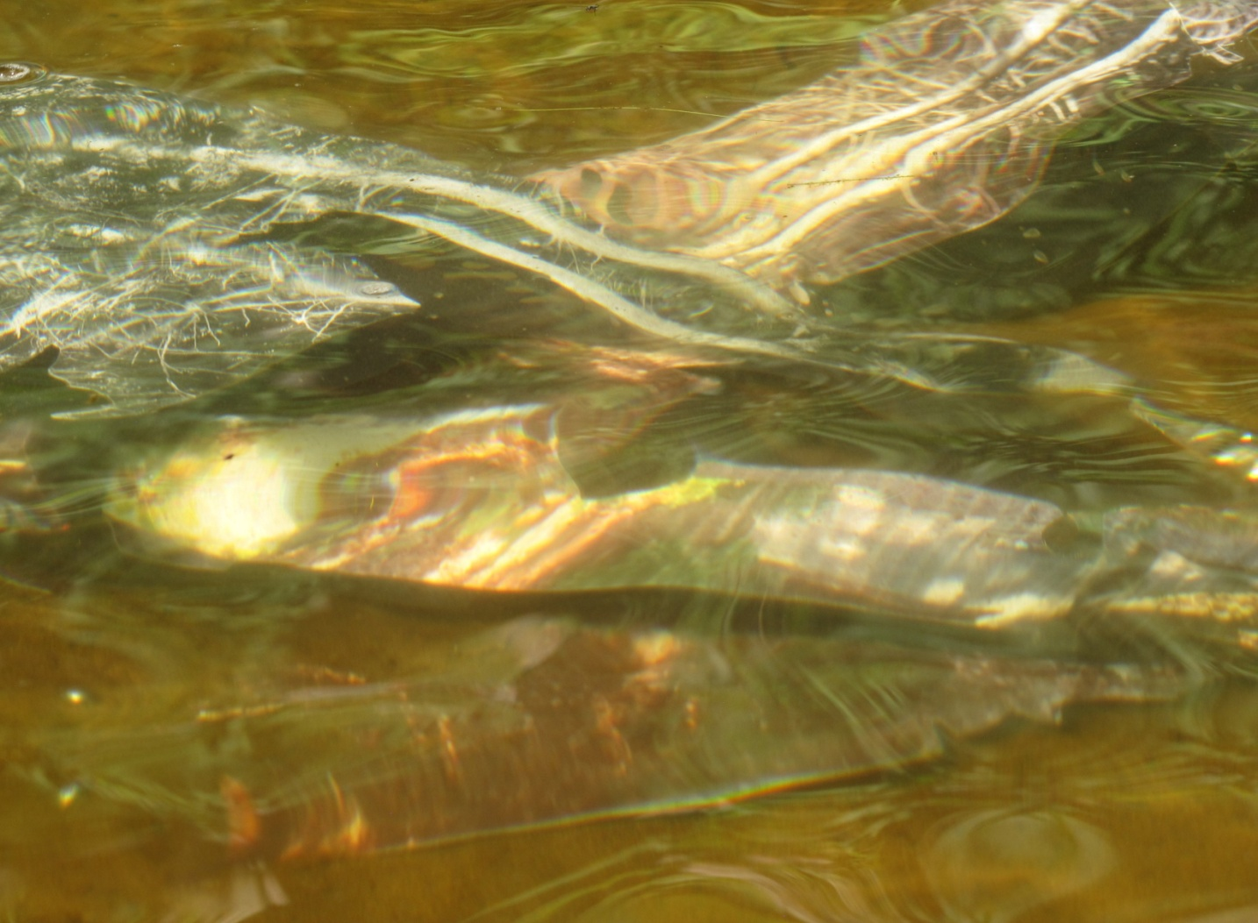
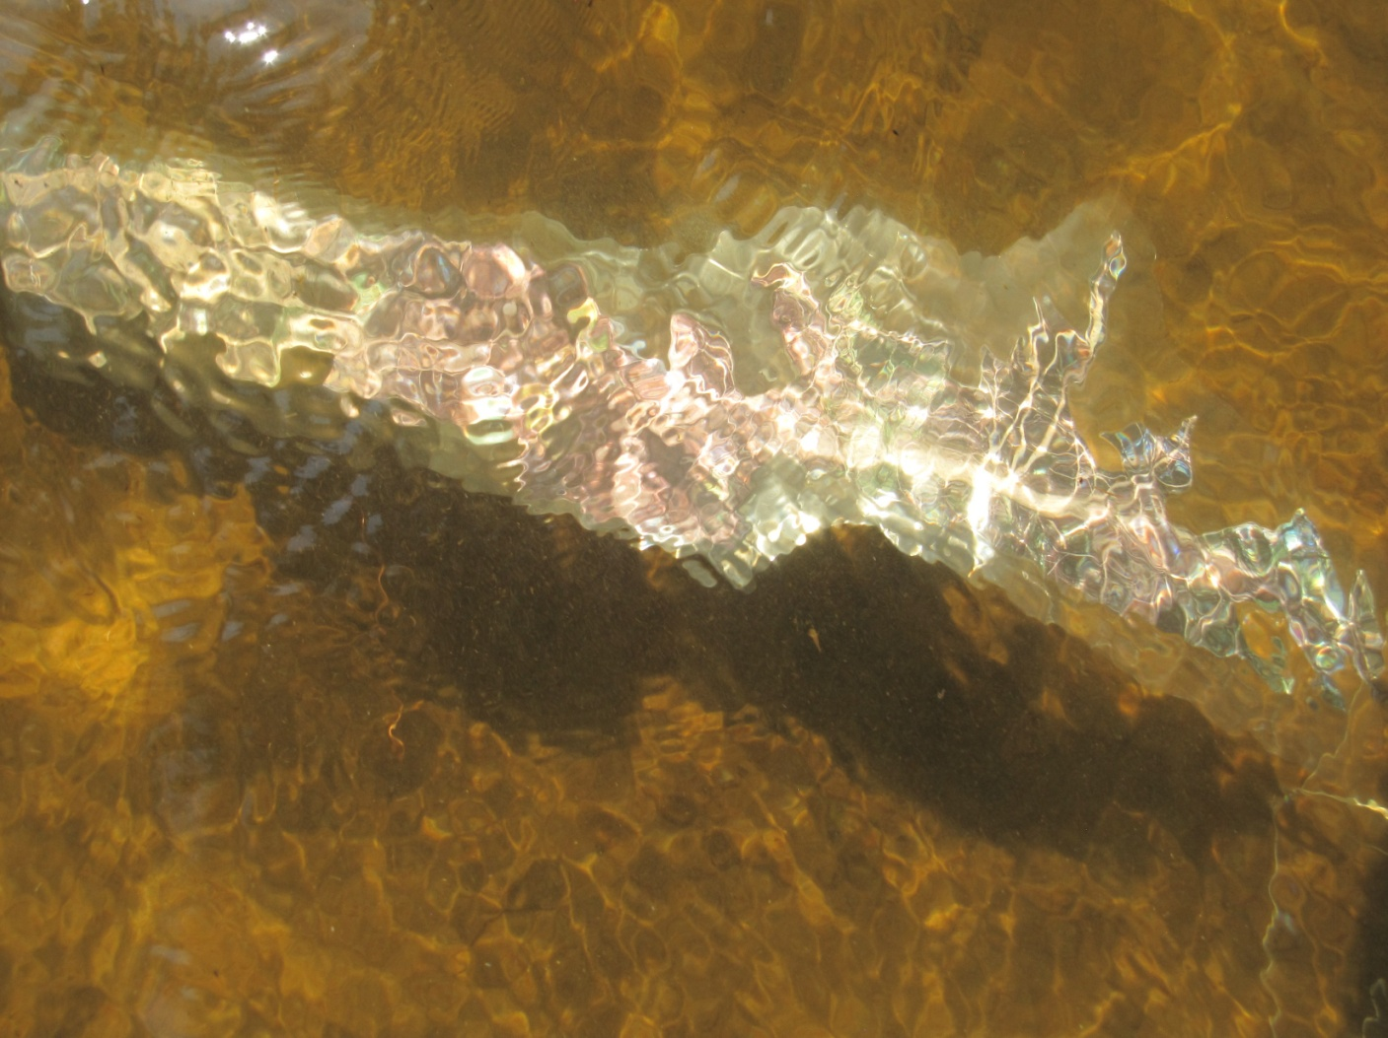
3

Slide 51
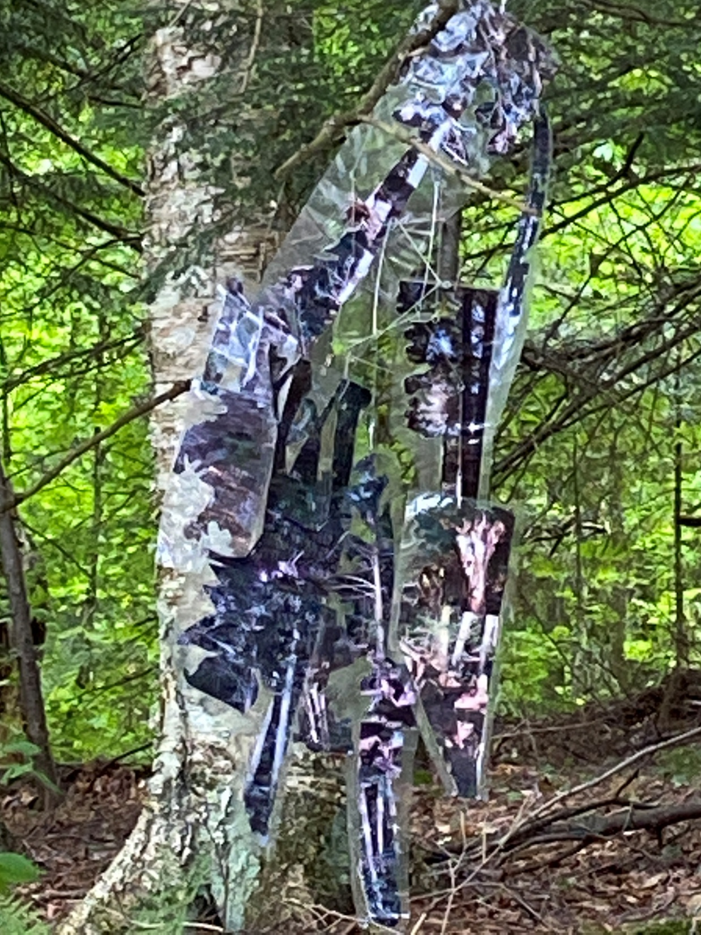
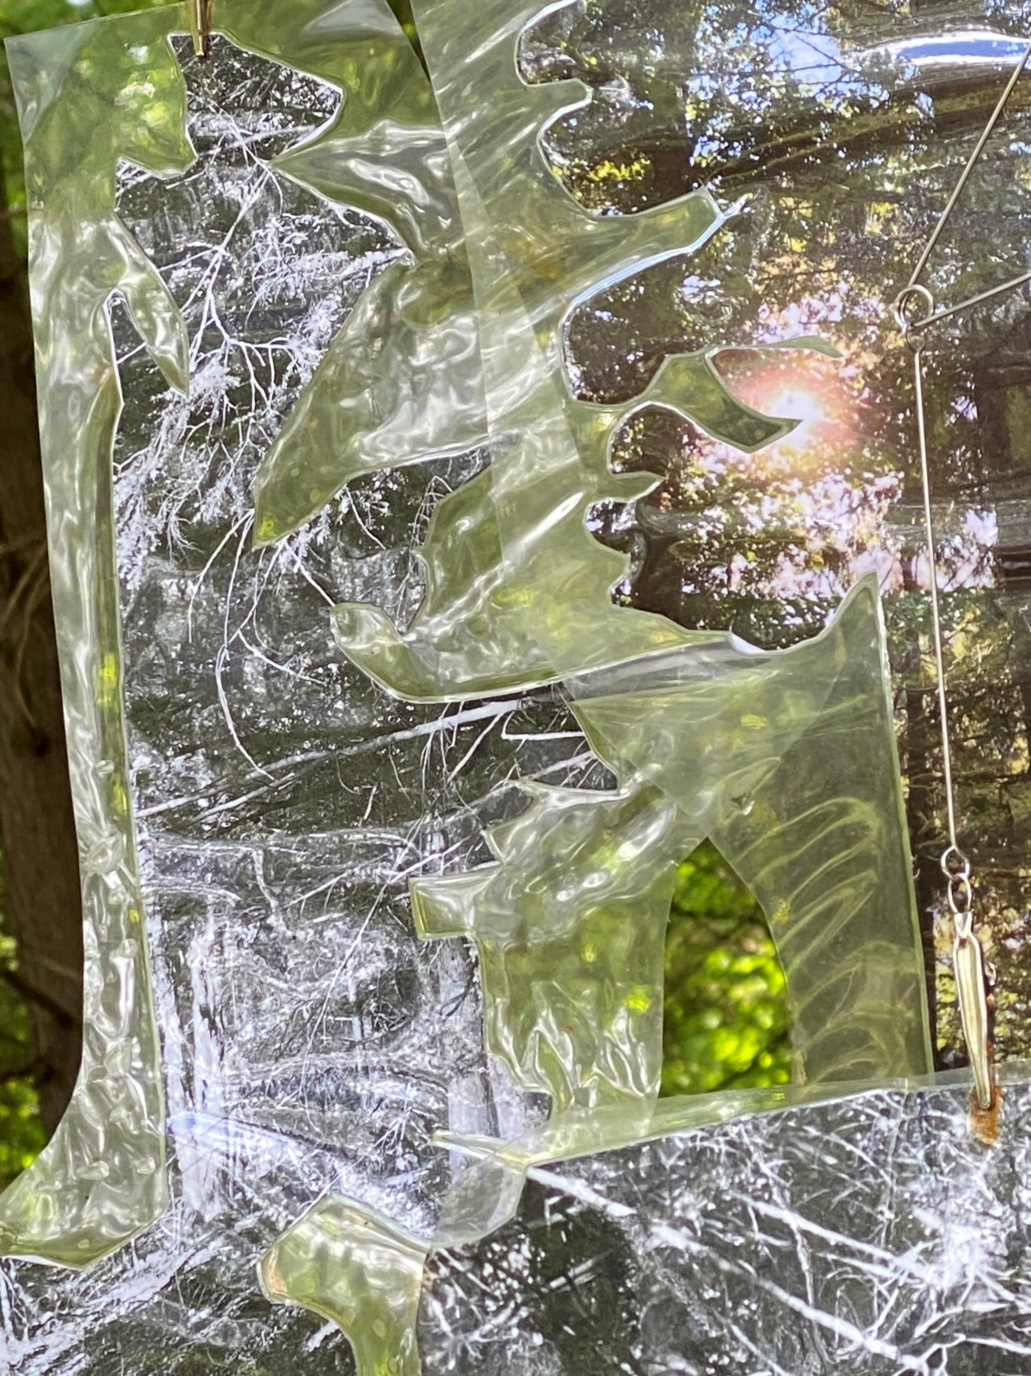
4

Slide 52
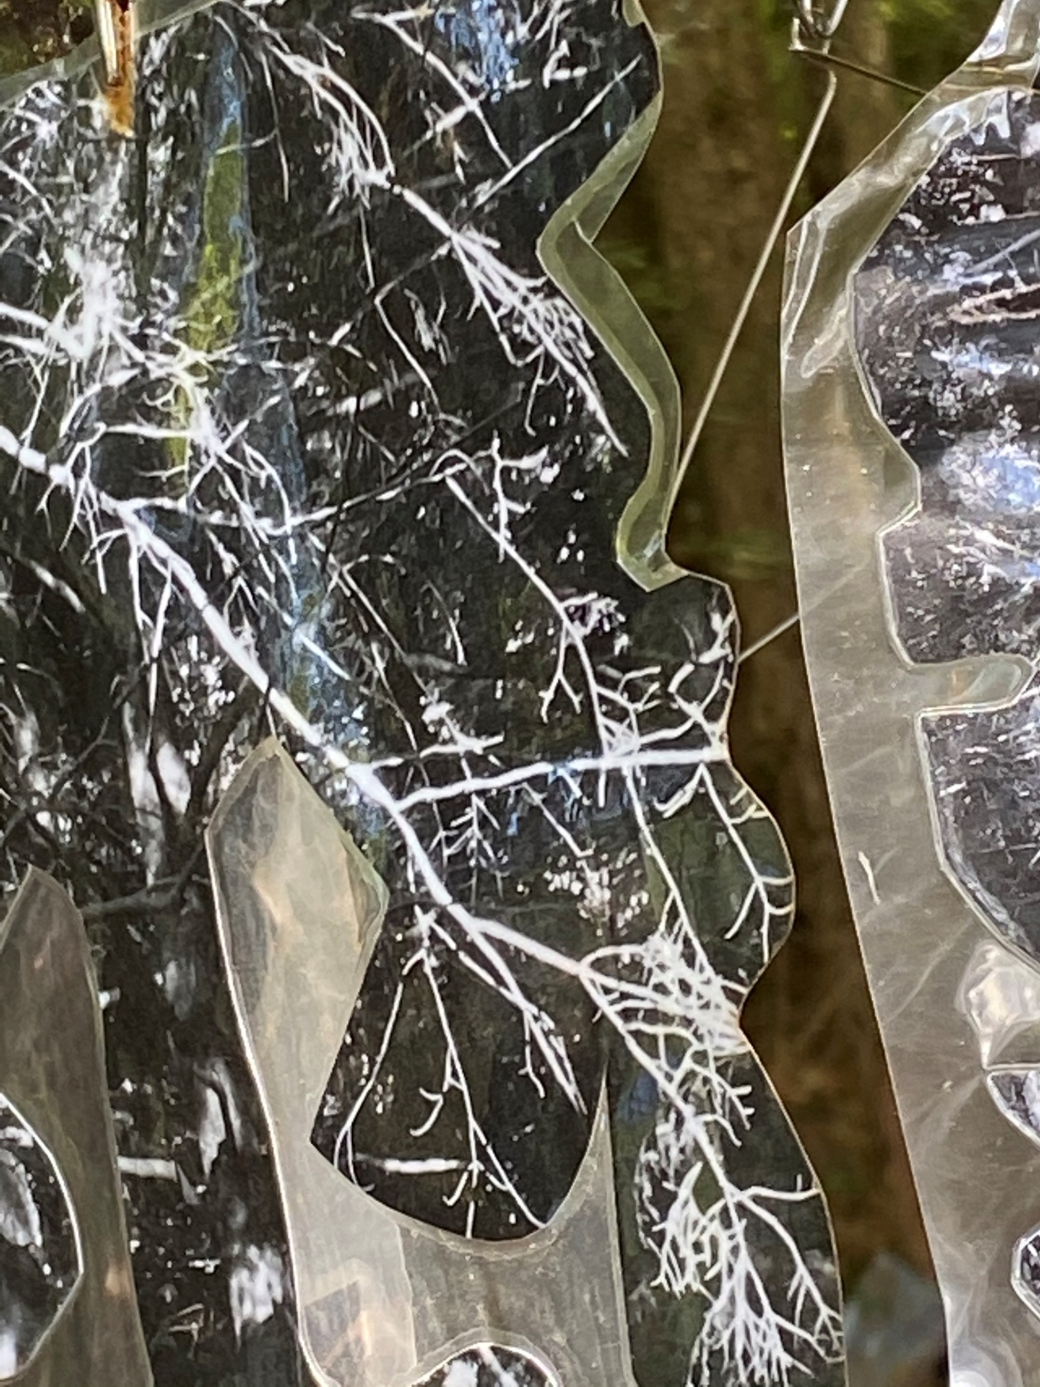
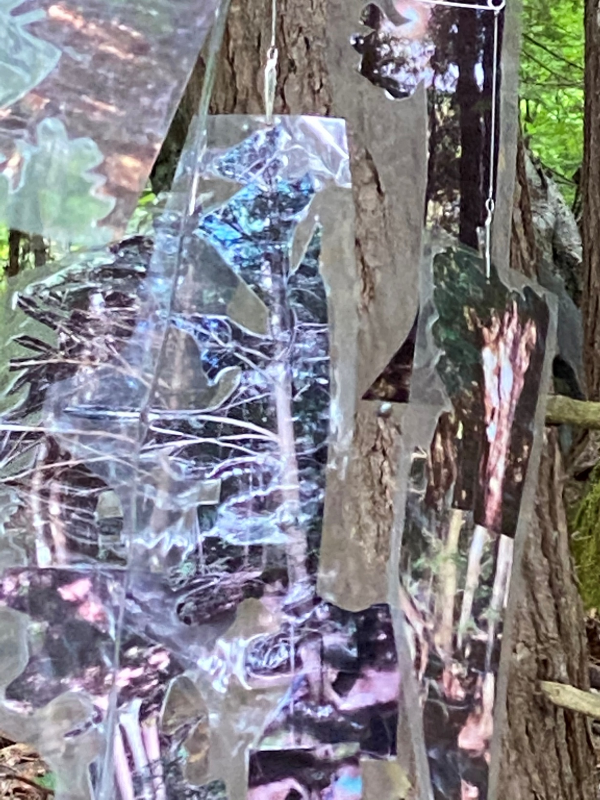
5

